Slide 1
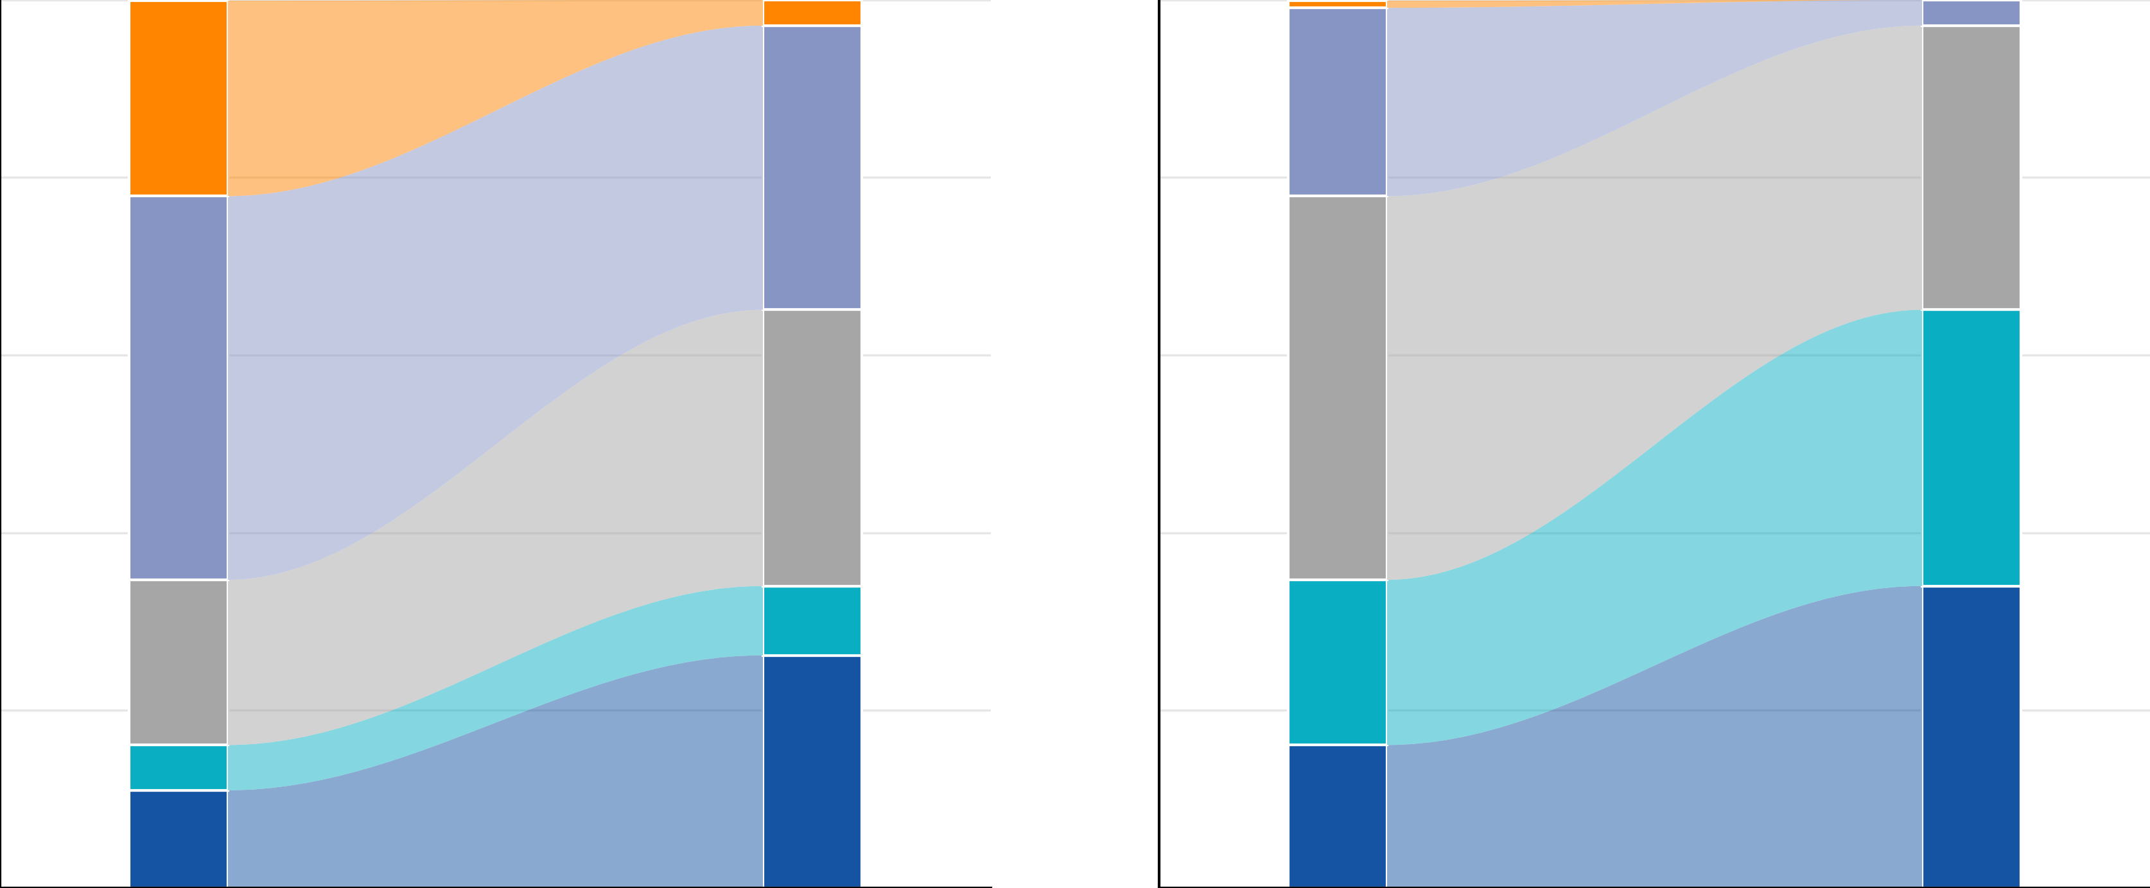
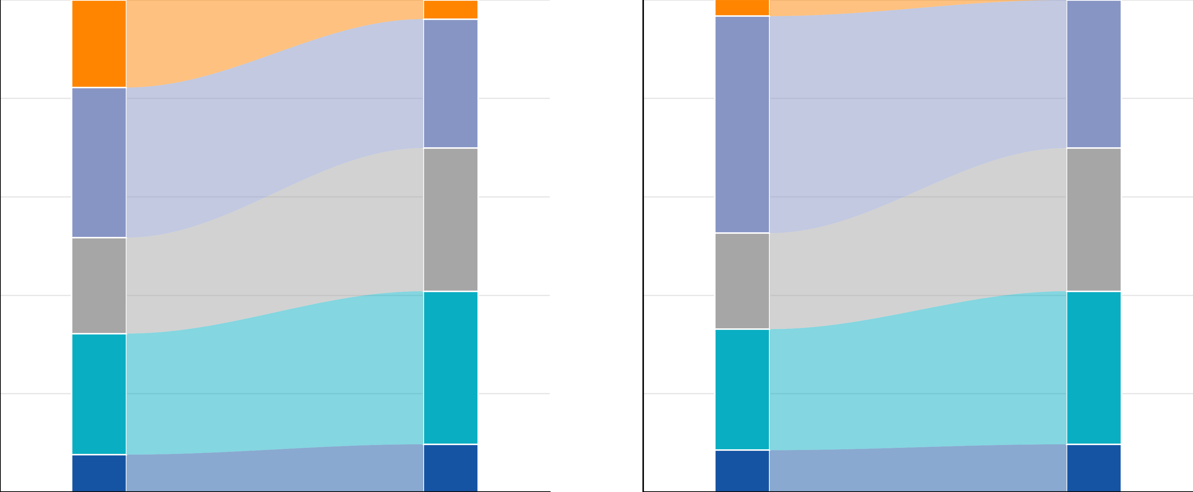

Impact of the Updated CTCAE Version 6.0 on Grading of Cytopenias Associated With Imetelstat
in Lower-Risk Myelodysplastic Syndromes
Logan Murray,¹ Ruben A. Mesa,² Dana Bogojevic,³ Qi Xia,³ Libo Sun,³ Jeff Braziunas,³ Michelle Mudge-Riley,³ David M. Swoboda¹
¹TGH Cancer Institute, Tampa General Hospital, Tampa, FL, USA; ²Atrium Health Wake Forest Baptist Comprehensive Cancer Center, Wake Forest University School of Medicine, Winston-Salem, NC, USA; ³Geron Corporation, Foster City, CA, USA
Introduction
Results
Figure 3. Maximum Postbaseline CTCAE Grade and Worsening Since Baseline in IMerge: Pooled Population (A) and Phase 3 Population (B)
The Common Terminology Criteria for Adverse Events (CTCAE) v6.0 was released in July 2025 to ensure that adverse event (AE) reporting remains aligned with current practice¹
Key updates to hematologic AE grading criteria included a general downward shift in grading thresholds, so that many laboratory abnormalities are assigned a lower grade compared with CTCAE v4.03 (Figure 1)^{2,3}
Neutropenia: Under CTCAE v6.0, grade 1 neutropenia below the lower limit of normal (LLN) is no longer reportable and absolute neutrophil count (ANC) of 1.5 × 10⁹/L to 1.0 × 10⁹/L is now grade 1 (this was formerly grade 2); grade 4 is stricter with a cutoff of <0.1 × 10⁹/L (previously <0.5 × 10⁹/L)
Thrombocytopenia: There are no changes to grade 1 and grade 2 criteria per v6.0, but the grade 3 threshold is broader and grade 4 more stringent; urgent intervention was incorporated into grade 4 criteria
Imetelstat is a first-in-class telomerase inhibitor approved for select patients with lower-risk myelodysplastic syndromes (LR-MDS) and red blood cell (RBC) transfusion-dependent (TD) anemia based on the results of the Phase 3 IMerge study (NCT02598661), in which imetelstat demonstrated clinically meaningful efficacy and a favorable safety profile⁴
In Phase 3 IMerge, using CTCAE v4.03 criteria, the most common grade 3 or 4 treatment-emergent adverse events with imetelstat were neutropenia (68%) and thrombocytopenia (62%), which were expected on-target effects^{4,5}
Cytopenias occurred predominantly during the first 3 cycles and were transient
They were not associated with an increased risk of serious clinical sequelae (bleeding, infection, or febrile neutropenia)
The analysis comprised 226 imetelstat-treated patients from the pooled IMerge population, including 118 from the Phase 3 population
Baseline characteristics are shown in Table 1
The median duration of imetelstat treatment was 33.6 weeks, with 40% of patients receiving ≥13 treatment cycles (Table 2)
A. Pooled Population (N=226)
B. Phase 3 Population (N=118)
Table 1. Baseline Characteristics in the Pooled Patient Population
Baseline patient and disease characteristics | Imetelstat (N=226)
Age, median (range), years | 71.0 (43-87)
≥65 years, n (%) | 174 (77)
WHO classification, n (%)
RS+ | 147 (65)
RS− | 78 (35)
Missing | 1 (<1)
IPSS risk category, n (%)
Low | 151 (67)
Intermediate-1 | 75 (33)
Prior RBC transfusion burden, n (%)
≤6 U/8 weeks | 112 (50)
>6 U/8 weeks | 114 (50)
Serum EPO level, n (%)
≤500 mU/mL | 155 (69)
>500 mU/mL | 64 (28)
Missing | 7 (3)
Transfusion burden per IWG 2018, n (%)
LTBª | 38 (17)
HTB^{b} | 188 (83)
We hypothesized that implementation of CTCAE v6.0 would alter the classification of
imetelstat-associated cytopenias, thereby affecting the interpretation of reported hematologic AEs
Figure 1. Updated CTCAE Criteria for Cytopenia Grading: Neutropenia (A) and Thrombocytopenia (B)^{4,5}
A. NEUTROPENIA
ANC, ×10⁹/L
ALL BOUNDARIES SHIFTED
Neutropenia
Thrombocytopenia
Neutropenia
Thrombocytopenia
v4.03
G1
G2
G3
G4
Figure 4. Maximum Postbaseline CTCAE Grade and Worsening Since Baseline by Cycle in IMerge Phase 3 Population (N=118): Neutropenia (A) and Thrombocytopenia (B)
<LLN–1.5
<1.5–1.0
<1.0–0.5
<0.5
v6.0
G1
G1 boundary shifted
G2
G2 boundary shifted
G3
G3 boundary shifted
A. Neutropenia
G4
CTCAE v4.03
2.9
0.8
CTCAE v6.0
0
<1.5–1.0
<1.0–0.5
<0.5–0.1
<0.1
100
22.0
21.2
2.9
B. THROMBOCYTOPENIA
Patients, %
80
43.2
32.0
43.2
32.0
Platelet count, ×10⁹/L
60
31.1
31.1
CHANGE LIMITED TO GRADES 3–4
40
18.6
7.8
18.6
34.0
20
5.1
26.2
16.1
v4.03
G1
G2
G3
G4
0
11.0
<LLN–75
<75–50
<50–25
<25
Cycles 1-3
Cycles 4-6
Cycles 1-3
Cycles 4-6
G1 boundary unchanged
G2 boundary unchanged
G3 boundary expanded
B. Thrombocytopenia
v6.0
G1
G2
G3
G4
100
17.8
CTCAE v4.03
3.9
3.4
CTCAE v6.0
0
<LLN–75
<75–50
<50–10
<10
Urgent intervention indicated
Patients, %
80
30.5
26.2
44.1
30.1
CTCAE, Common Terminology Criteria for Adverse Events; LLN, lower limit of normal.
LLN is displayed as a schematic endpoint, since CTCAE does not specify a numeric LLN.
Table 2. Imetelstat Exposure in the Pooled Patient Population
60
19.5
29.1
19.5
29.1
Methods
Imetelstat treatment exposure | Imetelstat (N=226)
Imetelstat treatment duration, median (range), weeks | 33.6 (0.1-260.1)
Number of imetelstat treatment cycles, n (%)
1-3 cycles | 34 (15)
4-6 cycles | 56 (25)
7-12 cycles | 46 (20)
≥13 cycles | 90 (40)
40
24.6
31.1
24.6
31.1
20
7.6
9.7
8.5
9.7
This post hoc analysis evaluated neutropenia and thrombocytopenia occurrence according to CTCAE v4.03 versus v6.0 in patients who received 7.1 mg/kg imetelstat administered as an intravenous infusion every 4 weeks
Analyses were conducted in the pooled IMerge population (Phase 2, Phase 3, and QTc substudy) and the randomized, placebo-controlled IMerge Phase 3 population (Figure 2)
0
Cycles 1-3
Cycles 4-6
Cycles 1-3
Cycles 4-6
No change
G1
G2
G3
G4
Figure 2. Pooled Study Design
Conclusions
Phase 2 IMerge⁶
Single-arm, open-label
Phase 3 IMerge⁴
Double-blind, randomized 2:1
QTc Substudy of Phase 3 IMerge⁷
Double-blind, randomized 2:1
Compared with CTCAE v4.03, the use of v6.0 substantially reduced reported grade 3 and 4 neutropenia and shifted thrombocytopenia grading toward more grade 3 events and fewer grade 4 events in the IMerge study
Although CTCAE v6.0 may offer advantages for future clinical studies, cytopenia assessment and management for imetelstat should remain consistent with the current prescribing information based on CTCAE v4.03
Patient population (all treated)
IPSS low- or INT-1–risk MDS
Relapsed or refractory to ESAs or EPO >500 mU/mL
Transfusion dependent: ≥4 RBC U/8 weeks over the 16-week prestudy period
Inclusion of del(5q) MDS and allowance of prior LEN and HMA use
Patient population (ITT)
IPSS low- or INT-1–risk MDS
Relapsed or refractoryª to ESAs or EPO >500 mU/mL (ESA ineligible)
Transfusion dependent: ≥4 RBC U/8 weeks over the 16-week prestudy period
Non-del(5q) MDS, no prior treatment with LEN or HMAs
Patient population differed from that of Phase 3 IMerge as follows:
Inclusion of patients with del(5q) MDS
Allowance of prior LEN and HMA use
Option to cross over from placebo to imetelstat after 2 cycles at the investigator’s discretion
EPO, erythropoietin; HTB, high transfusion burden; IPSS, International Prognostic Scoring System; IWG, International Working Group; LTB, low transfusion burden; RBC, red blood cell; RS, ring sideroblast; WHO, World Health Organization.
ªLTB defined as 3-7 RBC U in 16 weeks in ≥2 transfusion episodes and a maximum of 3 in 8 weeks. ^{b}HTB defined as ≥8 RBC U in 16 weeks or ≥4 RBC U in 8 weeks.
References
CTCAE and adverse event reporting. Accessed September 10, 2026. https://dctd.cancer.gov/research/ctep-trials/for-sites/adverse-events.
Common Terminology Criteria for Adverse Events (CTCAE) v4.03. Accessed September 1, 2026. https://evs.nci.nih.gov/ftp1/CTCAE/CTCAE_4.03/CTCAE_
4.03_2010-06-14_QuickReference_5x7.pdf.
Common Terminology Criteria for Adverse Events (CTCAE) v6.0 (MedDRA 28.0). Accessed September 1, 2026. https://dctd.cancer.gov/research/ctep-trials/for-sites/
adverse-events/ctcae-v6.pdf.
Platzbecker U and Santini V, et al. Lancet. 2024;403(10423):249-260.
Zeidan AM, et al. Blood Cancer J. 2026;16(1):55.
Steensma DP, et al. J Clin Oncol. 2021;39(1):48-56.
Komrokji RS, et al. Br J Haematol. 2026;208(2):737-741.
Imetelstat
7.1 mg/kg active dose
(equivalent to 7.5 mg/kg imetelstat sodium)
IV every 4 weeks
(n=57)
Imetelstat
7.1 mg/kg active dose
(equivalent to 7.5 mg/kg imetelstat sodium)
IV every 4 weeks
(n=118)
Imetelstat
7.1 mg/kg active dose
(equivalent to 7.5 mg/kg imetelstat sodium)
IV every 4 weeks
(n=35)
In the pooled IMerge population, grade 3 and 4 neutropenia were reported in 39.8% and 29.6% of patients, respectively, using CTCAE v4.03, compared with 26.1% and 3.5% using v6.0 (Figure 3)
Grade 3 and 4 thrombocytopenia occurred in 39.8% and 21.2% of patients, respectively, using v4.03, versus 56.6% and 4.0% using v6.0
Similar cytopenia grading shifts were observed in the Phase 3 population (Figure 3)
Across both populations, grade ≥3 neutropenia and thrombocytopenia generally occurred early during imetelstat treatment and were transient (Figure 4)
Cytopenias were associated with low rates of infection and bleeding compared with placebo²
Data cutoff date: October 13, 2023
Placebo
Crossover from placebo to imetelstat
(n=16)
Acknowledgments
The authors thank all the patients and caregivers for their participation in this study and acknowledge the collaboration and commitment of all investigators and their research support staff
This study was funded by Geron Corporation
All authors contributed to and approved the presentation; writing and editorial support were provided by Meredith Rogers, MS, CMPP, of
The Lockwood Group (Stamford, CT, USA), funded by Geron Corporation
Data cutoff date: October 13, 2023
Data cutoff date: October 13, 2024
Copies of this poster obtained through the Quick Response (QR) code are for personal use only and may not be reproduced without permission from the author of this poster.
EPO, erythropoietin; ESA, erythropoiesis-stimulating agent; Hb, hemoglobin; HMA, hypomethylating agent; INT, intermediate; IPSS, International Prognostic Scoring System;
ITT, intention-to-treat; IV, intravenous; LEN, lenalidomide; MDS, myelodysplastic syndromes; QTc, QT correction; RBC, red blood cell.
ªReceived ≥8 weeks of ESA treatment (EPO alfa ≥40,000 U, EPO beta ≥30,000 U, or darbepoetin alfa 150 µg or equivalent per week) without Hb rise ≥1.5 g/dL or decreased RBC transfusion requirement ≥4 U every 8 weeks or transfusion dependence or reduction in Hb by ≥1.5 g/dL after hematologic improvement from ≥8 weeks of ESA treatment.
Presented at the Florida Society of Clinical Oncology (FLASCO) Fall Congress; October 9-10, 2026; Tampa, FL, USA
ClinicalTrials.gov: https://clinicaltrials.gov/study/NCT02598661
Contact information: Medinfo@geron.com

